Slide 1

Customer Churn Prediction
Using Machine Learning to Identify Attrition Factors
Course: Quality Assurance
Team: Data Wizards
University: Tech University

Slide 2


Dataset Overview
Bank Churners Dataset
•
Scale: Contains over 10,000 anonymized customer records.
•
Goal: Predict the Attrition_Flag (Existing vs. Attrited).
•
Feature Categories:
○
Demographic: Age, Gender, Education Level, Marital Status.
○
Financial: Income Category, Credit Limit, Card Category.
○
Behavioral: Transaction Count, Total Amount, Inactivity Months.

Slide 3


Project Goal
The Problem
Our Objective
Customer churn significantly impacts revenue and long-term growth. Identifying at-risk customers solely through manual review is inefficient and reactive rather than proactive.
“To predict customer churn and identify the key factors that influence customer attrition using data analysis and machine learning techniques.”

Slide 4





Project Workflow (Data Lifecycle)
Preparation
Analysis
Modeling
Evaluation
Data Import & Cleaning
Handling Nulls
Exploratory Data Analysis
Feature Engineering
Statistical Analysis
Model Training
Performance Metrics
Business Insights

Slide 5








Data Cleaning & Preprocessing
Handling Missing Values
Encoding Variables
Data Consistency
Converted categorical features like 'Gender' and 'Education_Level' into numeric formats suitable for ML algorithms.
Verified data types and removed duplicate records to ensure the model learns from high-quality, unique observations.
Identified and treated null values in demographic fields using mode imputation to maintain dataset size and integrity.

Slide 6
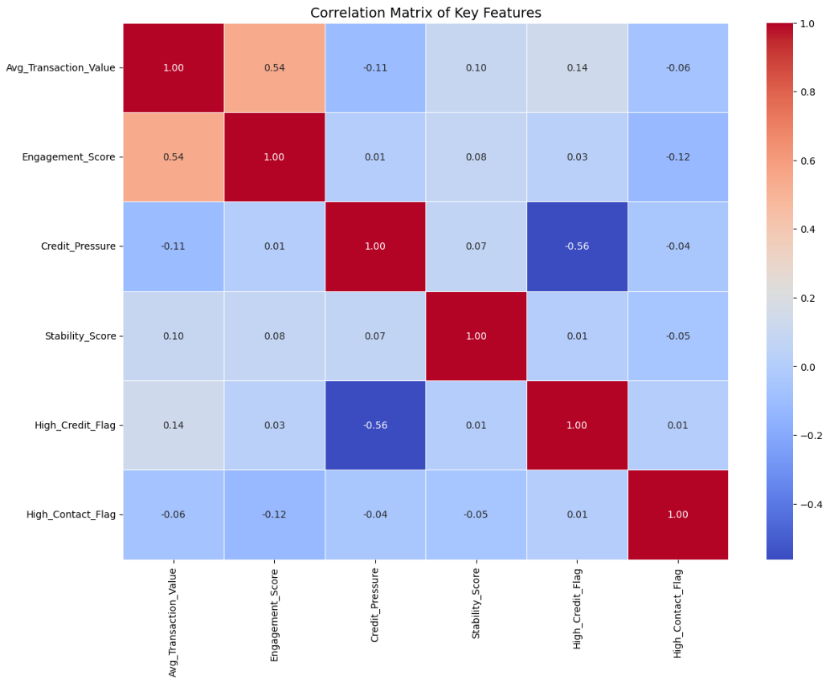
Exploratory Data Analysis
Distribution Analysis: Uncovered skewed distributions in credit limits, suggesting the need for normalization.
Correlation Analysis: The heatmap helps identify highly correlated features (multicollinearity) to reduce noise in the model.
Churn vs. Behavior: Clear patterns emerged showing churned customers tend to have significantly lower transaction counts and revolving balances.

Slide 7
Feature Engineering
Transforming raw data into meaningful predictors to improve model accuracy.
Engagement Score: A composite metric combining transaction count and total transaction amount to measure overall activity.
Average Transaction Value: Calculated as Total Amount / Transaction Count to identify high-value users.
Credit Pressure: Ratio of Total Revolving Bal / Credit Limit, indicating financial stress.
Tenure Grouping: Segmenting customers into 'New', 'Established', and 'Long-term' to capture lifecycle effects.
Transaction Frequency Groups: Categorizing users into Low, Medium, and High frequency bins.

Slide 8
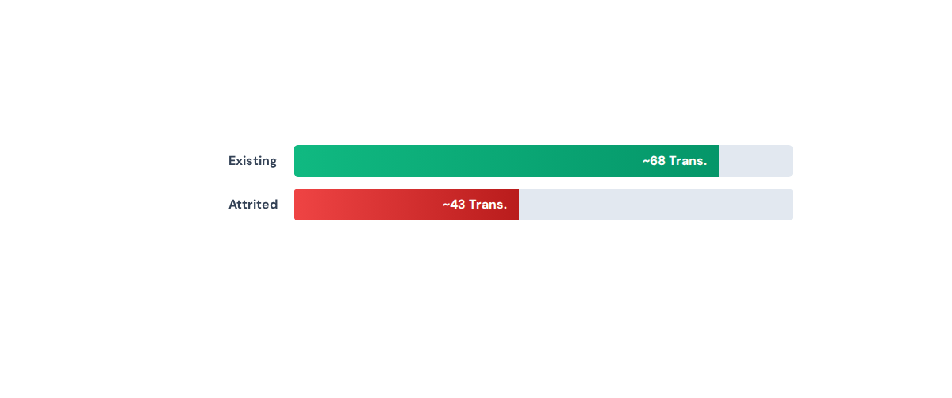
Statistical Analysis: Churn Patterns
Comparison of Average Transaction Count: Existing vs. Attrited Customers
"Statistical grouping reveals that churned customers perform nearly 40% fewer transactions on average, validating this feature's predictive power."

Slide 9








Modeling Strategy
Data was split 80/20 for training and testing to ensure valid evaluation.
Logistic Regression
Decision Tree
Random Forest
Used as a baseline model to understand linear relationships and establish a performance benchmark.
Implemented to capture non-linear patterns and visualize decision rules for better interpretability.
Selected Model: Chosen for its robustness against overfitting and superior accuracy (Ensemble Method).

Slide 10

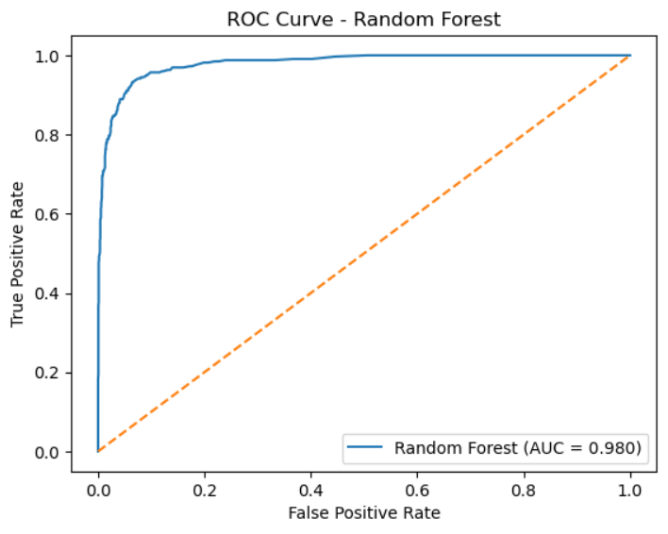
Model Evaluation
Random Forest Performance
Accuracy | 94.9%
Precision | 90.8%
Recall | 76.3%
F1-Score | 82.9%
ROC-AUC | 0.97

Slide 11
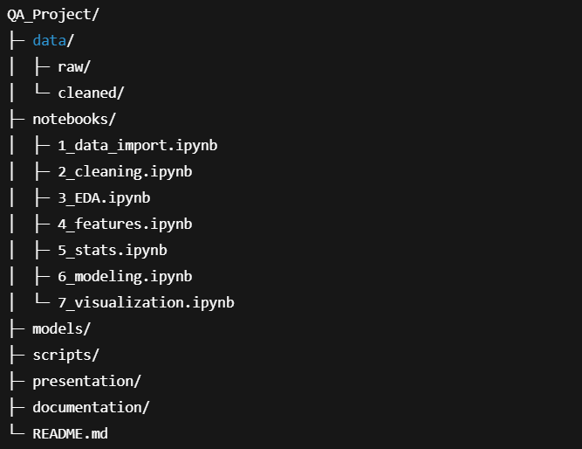
Version Control & Collaboration
GitHub Implementation
Version Control: Tracked changes in data processing and modeling scripts.
Collaboration: Facilitated teamwork through branching and pull requests.
Reproducibility: Standardized folder structure for easy deployment.
github.com/Abdo-Hafez-0/QA-Project

Slide 12

Conclusion & Insights
Key Insight: Transaction Count and Total Transaction Amount are the strongest predictors of customer churn.
Business Value: The Random Forest model can identify at-risk customers with 94% accuracy, enabling proactive retention campaigns that could save estimated 15% of potentially lost revenue.

